Slide 1
HR MANAGMENT PRoject
DEVELOPERS
Ömer Faruk Azili 210444026
Fevzi Fidan 210444056
Hikmet Çatak 210444017
25.12.2024
INSTRUCTOR
Ahmet Serkan Karataş
Ceng-301
Department of Computer Engineering

Slide 2
Project Goal
Saving Workers Information
Processes
Workers Information
User friendly interface

Slide 3
Technical Details of the Project

Slide 4
Programming Tools Overview
Database : MySQL
Programming Language : Python
Important Libraries : pymysql
Ui: pyqt

Slide 5
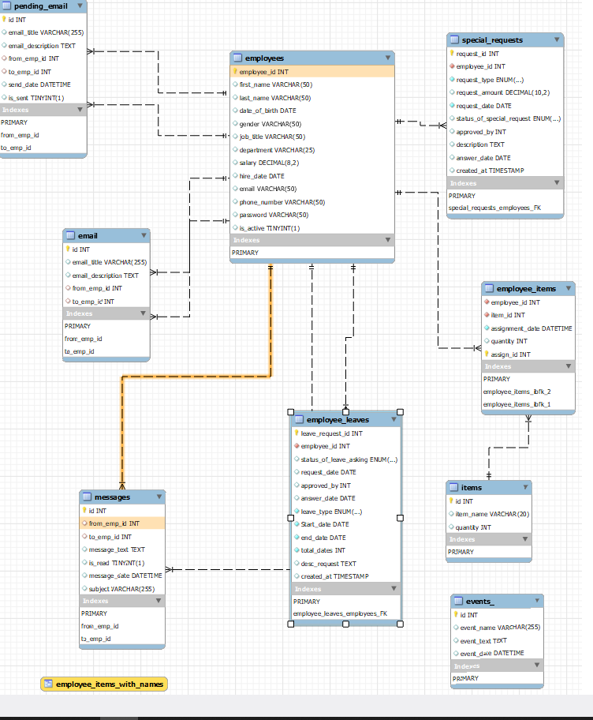
DIAGRAM

Slide 6
Features
Manager Side:
✅-Hiring Employee
✅-Dismissal
✅-Item Assignment Registration System
✅-Salary Adjustment
✅-Search
✅-Scheduled Automatic Mail System
✅-View Employee Information and General Statistics
✅-Get Direct Messages from Employees via System
✅-Event Planning Transactions (education, conference, entertainment)
✅-Sending Direct Message to Human Resources via System
✅-Expense Reimbursements
✅-Advance Transactions
✅-Bonus Transactions
✅-Leave Definitions
Employee Side:
✅-Viewing Their Information
✅-Viewing General
✅-Announcements and Events
✅-Leave Request System
✅-Advance Request System
✅-Expense Reimbursement Request System
✅-Viewing Items Assigned to Them

Slide 7
MANAGER SIDE

Slide 8
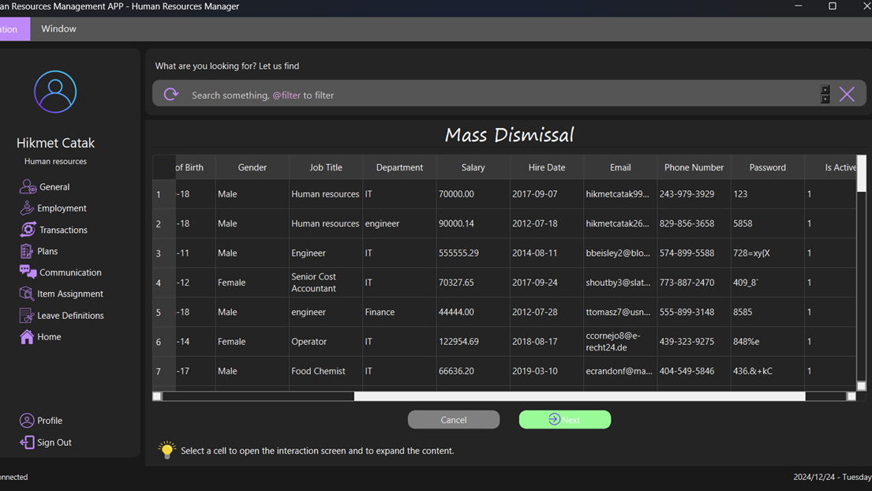

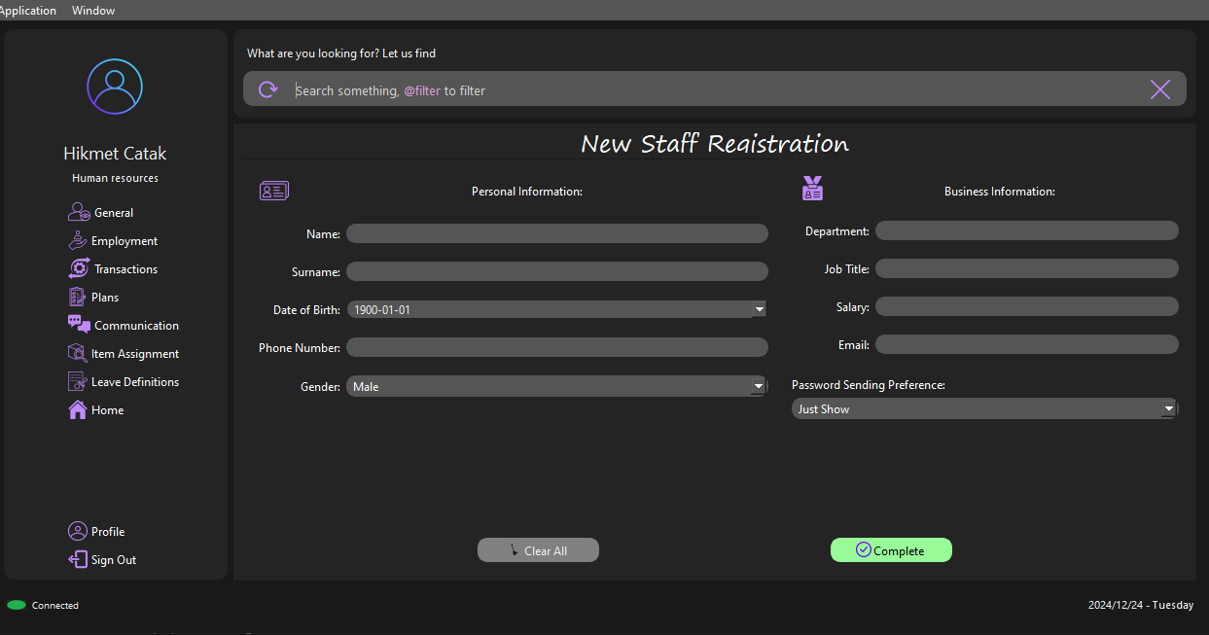


Slide 9
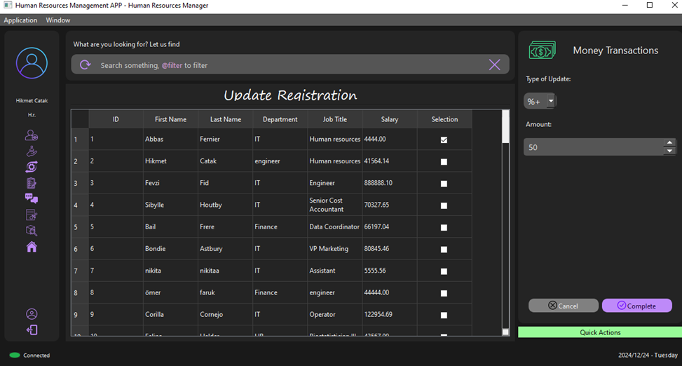
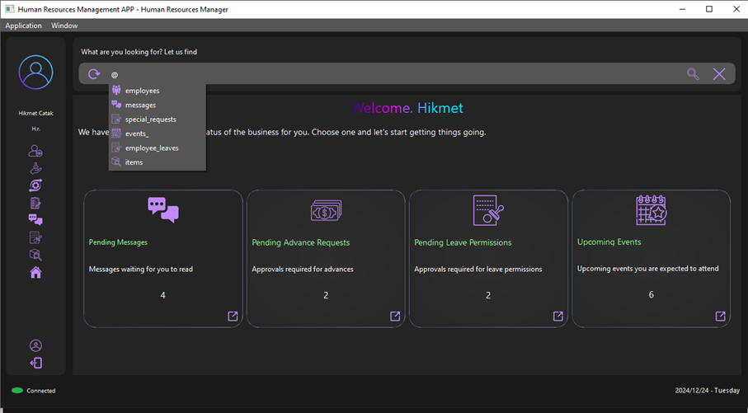


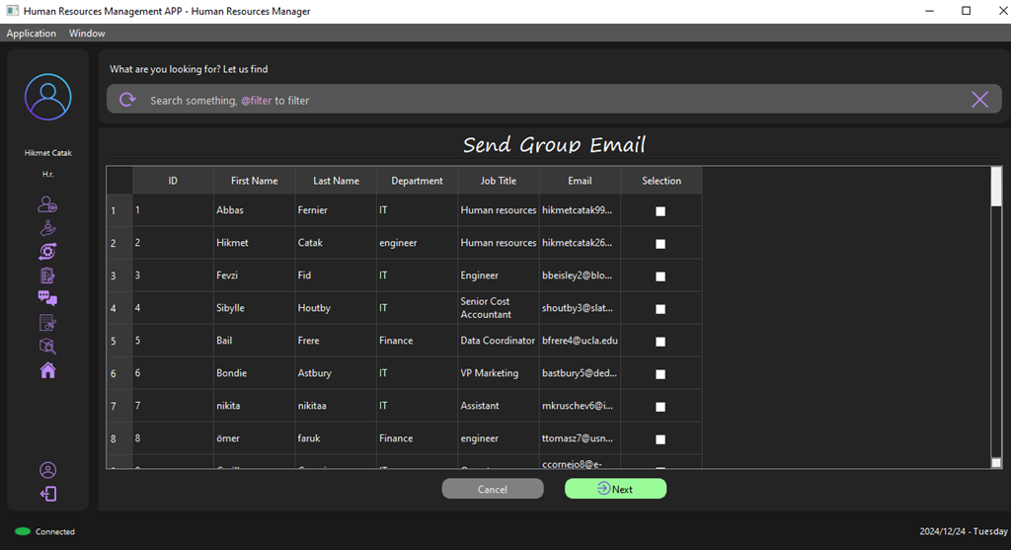
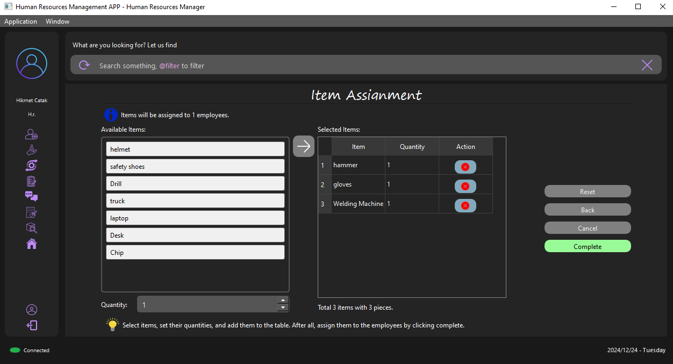



Slide 10
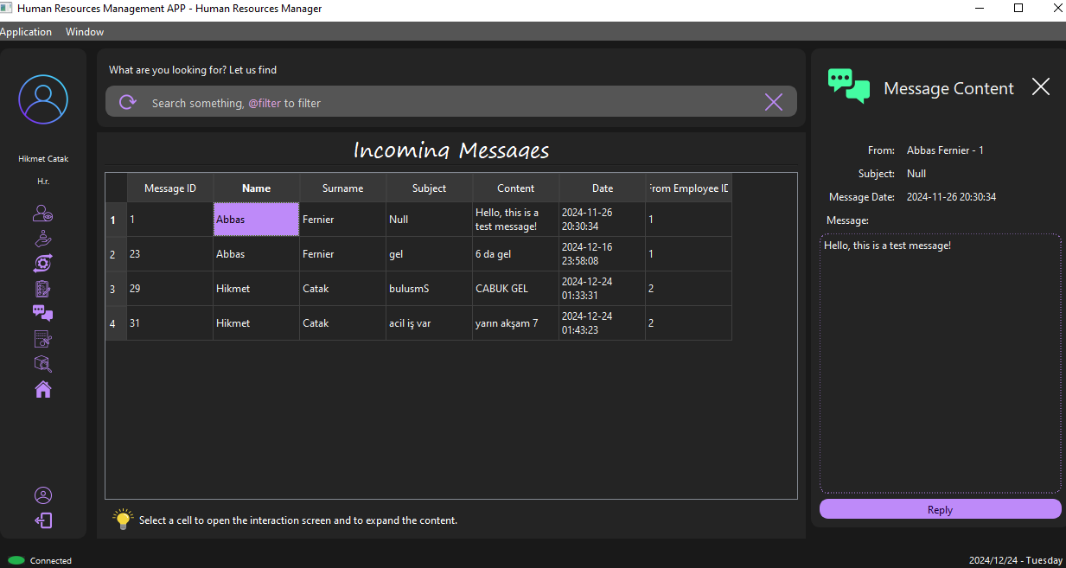
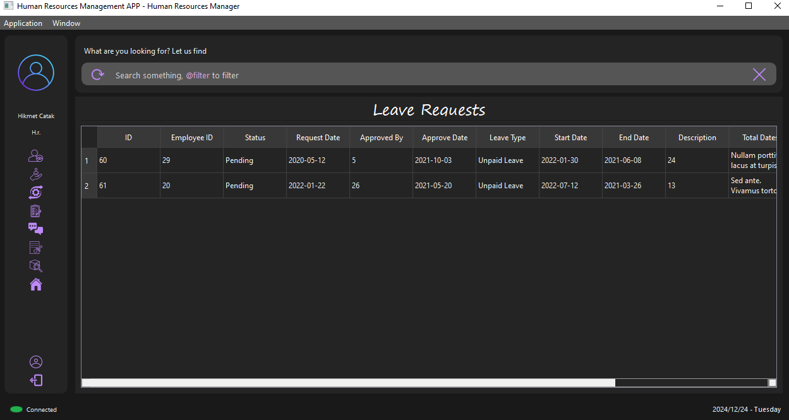


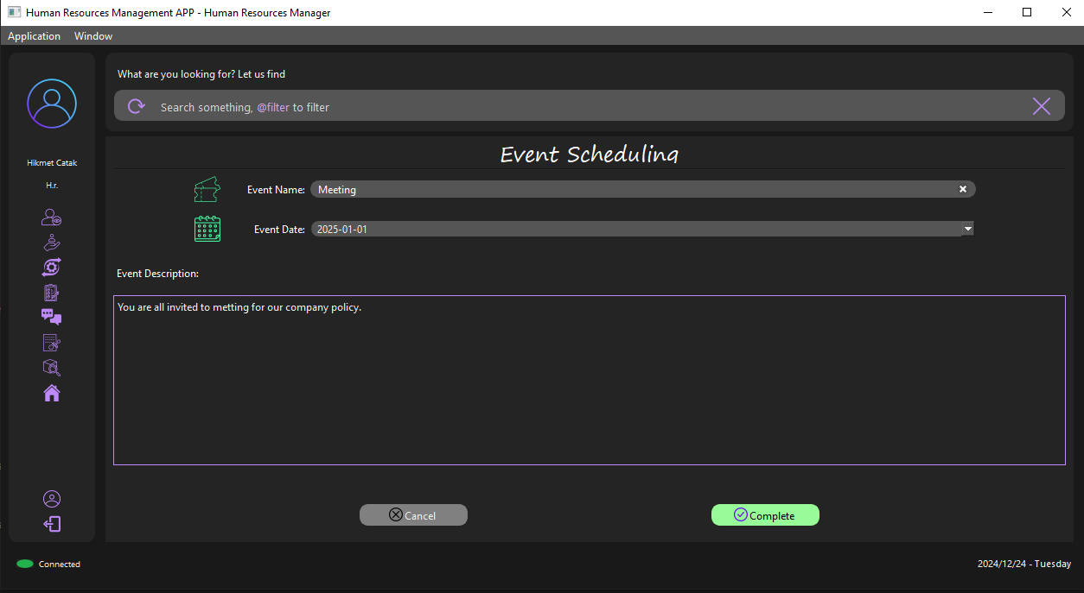


Slide 11
Employee sıde

Slide 12
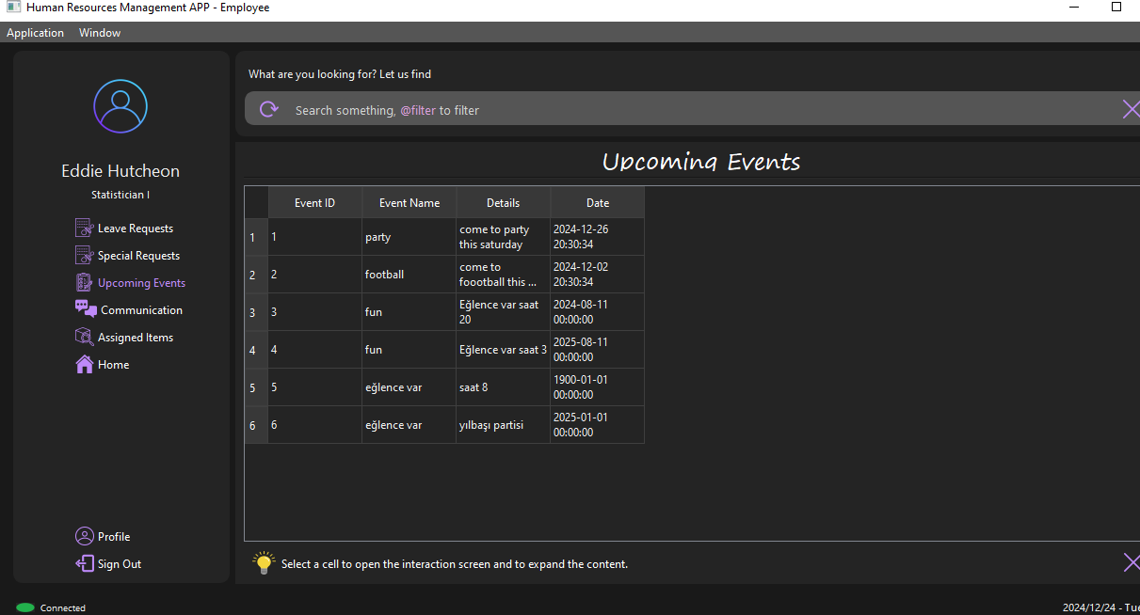

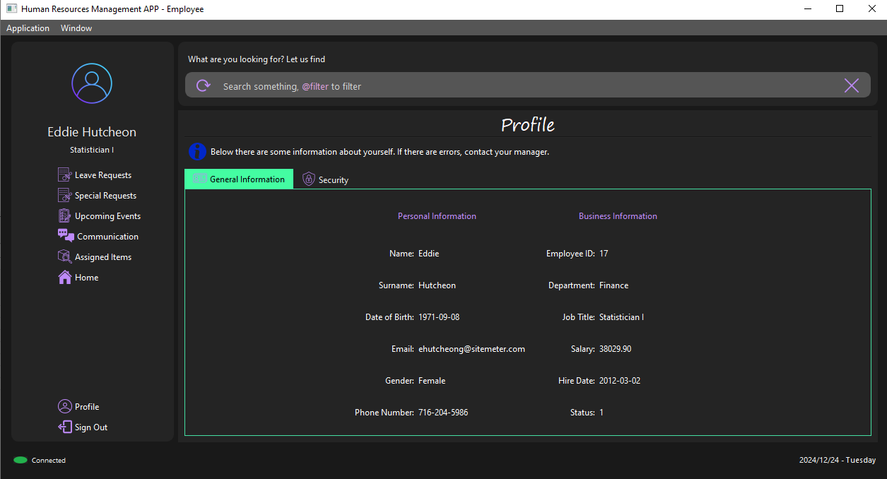


Slide 13
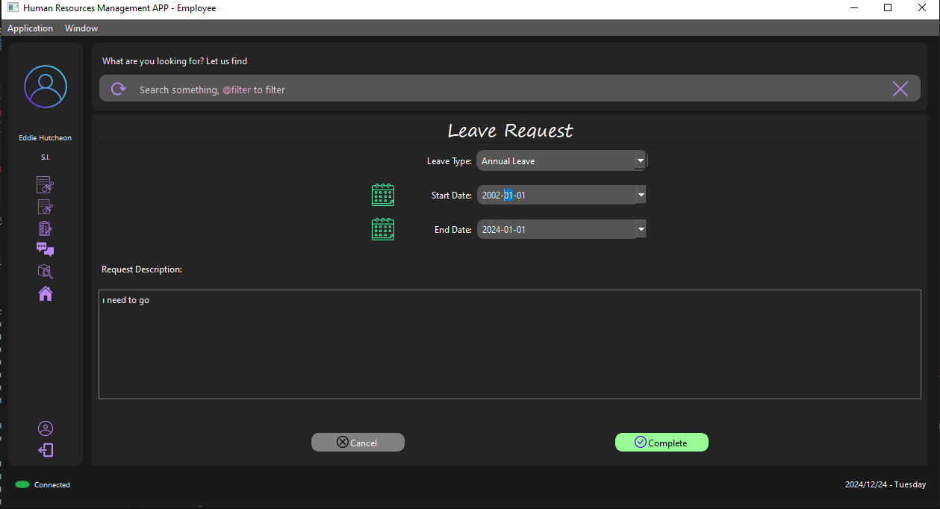

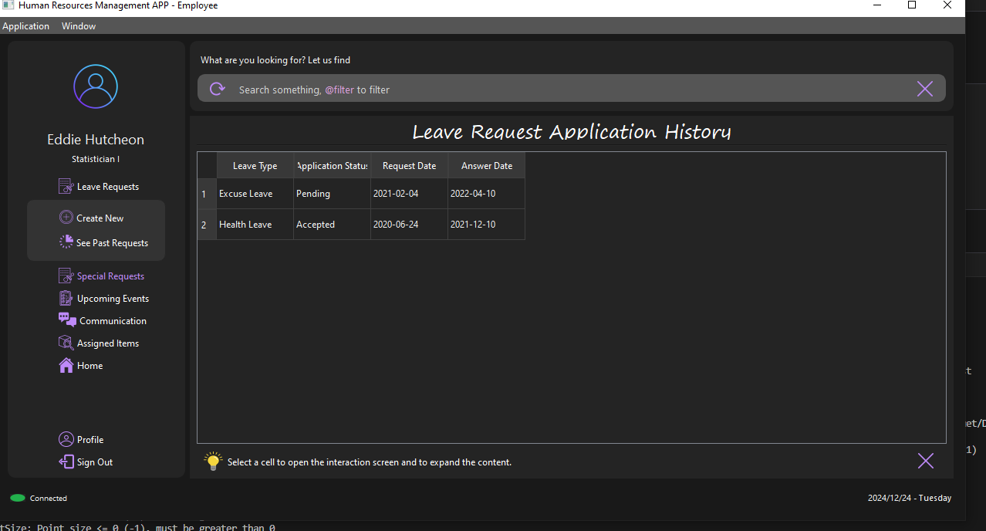



Slide 14
Planned Enhancements
Adding Weekly Working Hours
Statistical Data Analysis
Layered System for Managers

Slide 15
Learnings and Contributions
Database Management
Error Management
UI Experience
Data Validation
Comprehensive Sql Queries
Communication Skills
Work as a Team
Make better coffee

Slide 16
Now it's demo time

Slide 17
thank you for listening to US

